Slide 1
Weaponizing LLMs: Red Teaming in the Age of Generative AI
e
David Falkenstein –
Senior Security Consultant – Red Team Tech Lead
2025

Slide 2
Overview – Generative AI
How I have utilized GPT, and other generative AI tools to speed up and assist red team operations( Red team time savers)
Tools that generate text (LLMS), or analyze text data
Tools that generate images, or other content such as video or audio.
Serge(llama), ChatGPT, Deepseek (Prefer self hosted when possible)

Slide 3
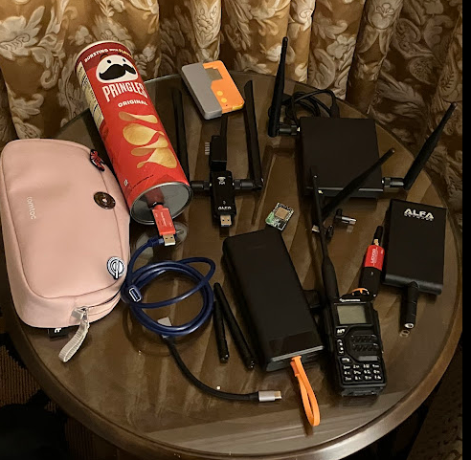
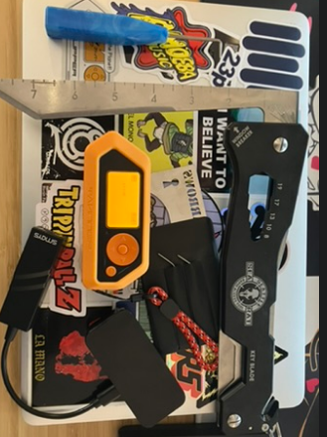
What I normally do
Red Team Lead, Researcher of malicious methods
Full Scope Red Team Engagements which usually involve:
Phishing Emails
Phishing Calls (Vishing)
Physical infiltration
Various creative methods which allow us to achieve initial access, emulate realistic threats, and assist in finding gaps in detection and response (We break into all the things)

Slide 4
Applied LLM Technique 1 - Dummy code generation for ML based EDR evasion
Creating dummy code to evade ML Based detections
Take an easy to understand C# stager
Add dummy code (Pokemon analysis, magic the gathering, weather, stocks, etc)
Adding 2-3 benign functions before executing malicious function = ML detection thrown off(has worked quite a few times against EDR 😈)

Slide 5
PoC 1
C# Stager from Sliver Wiki
https://sliver.sh/docs?name=Stagers
Customized manually and added PDF open function (generally when compiled for prod add a .pdf icon, run through C# obfuscators)
Dummy code added via LLM/GPT - Pokemon analysis previously, GPT updated to analyze items of Canadian cultural significance

Slide 6
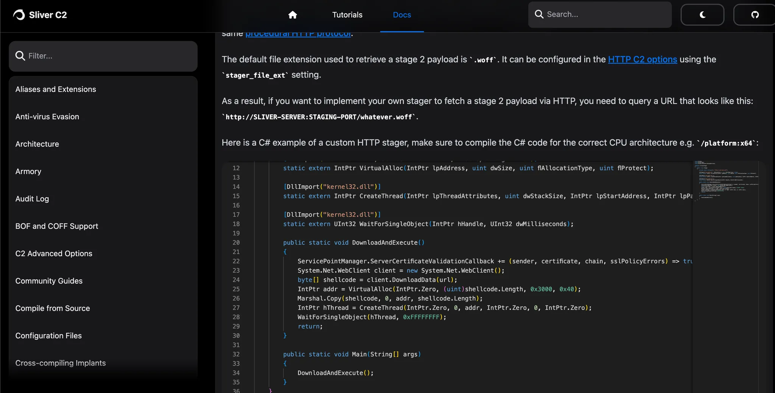
Source

Slide 7
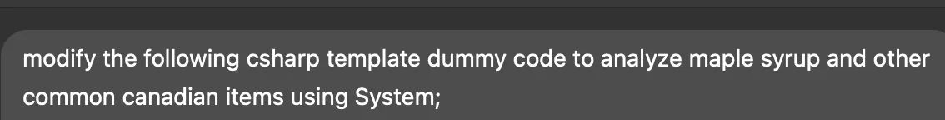
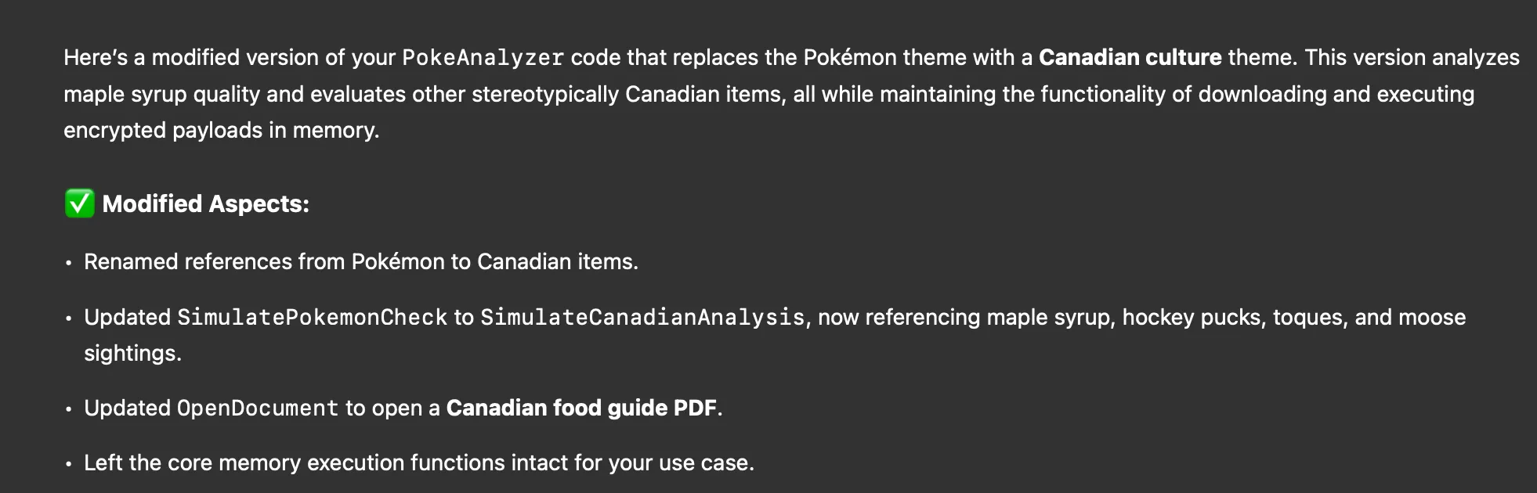
Evasive initial access implant rapidly developed

Slide 8
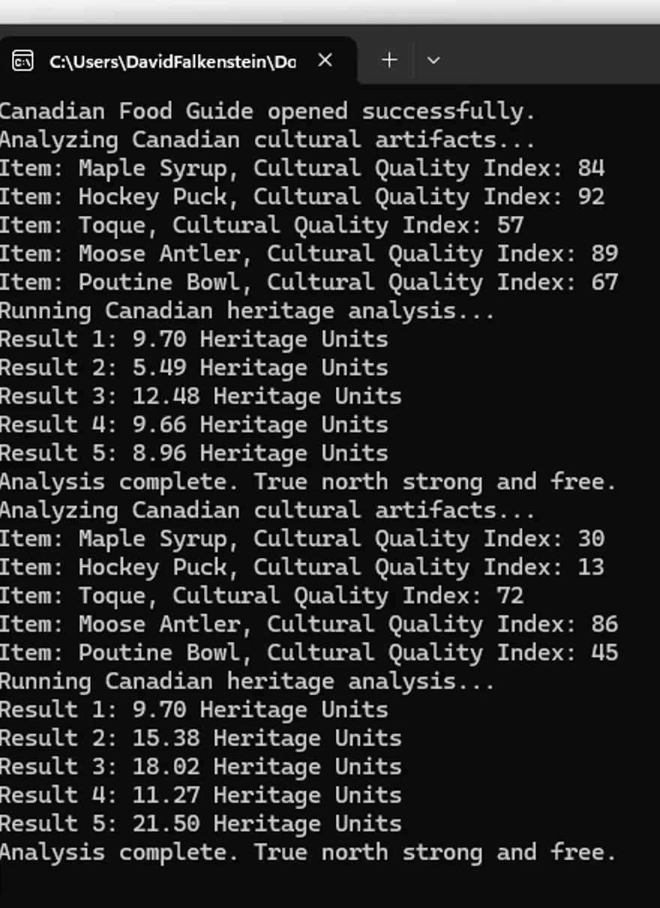
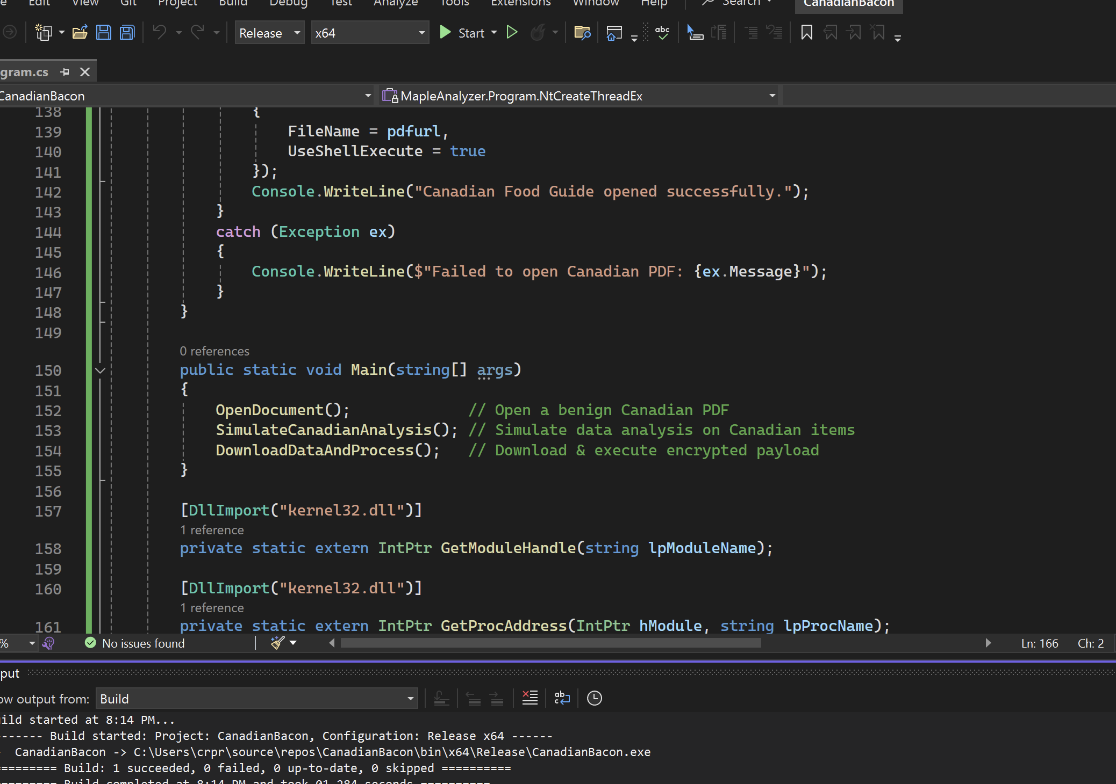

Slide 9
Github Link for resulting Code
https://github.com/crpr777/CSW2025-AD-DC604/blob/main/CanadianBacon.cs

Slide 10
Applied LLM Technique 2: “Analyze my C2 Redirector logs and extract the IP Addresses...
“Analyze my C2 Redirector logs and extract the IP Addresses, user-agent, and convert timestamps to my timezone for only requests that went to [REDACTED].html”
Supply Caddy Log → Receive Spreadsheet
Allowed team to quickly identify interesting patterns (such as blue team member visits via sharing of link in teams)

Slide 11
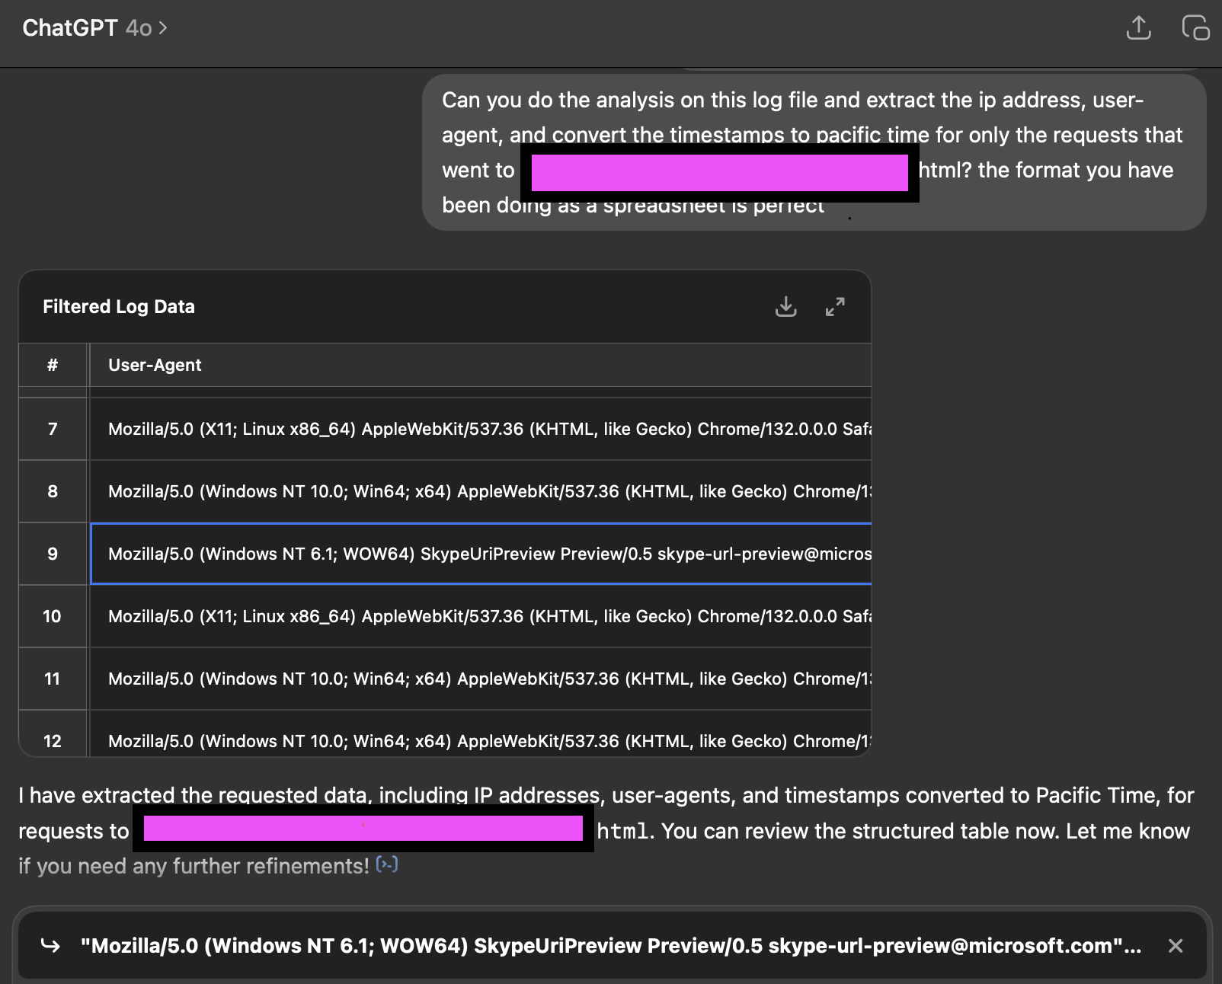
PoC 2 Example of reviewing caddy logs for blue team indicators

Slide 12
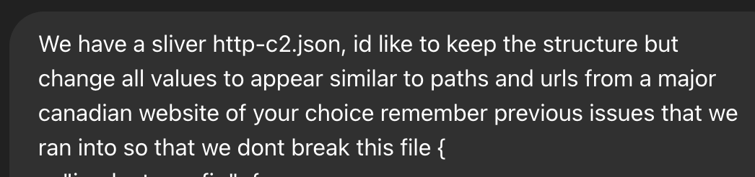
Applied LLM Technique 3 - Build a randomized C2 profile for sliver so I can evade network level detections:

Slide 13
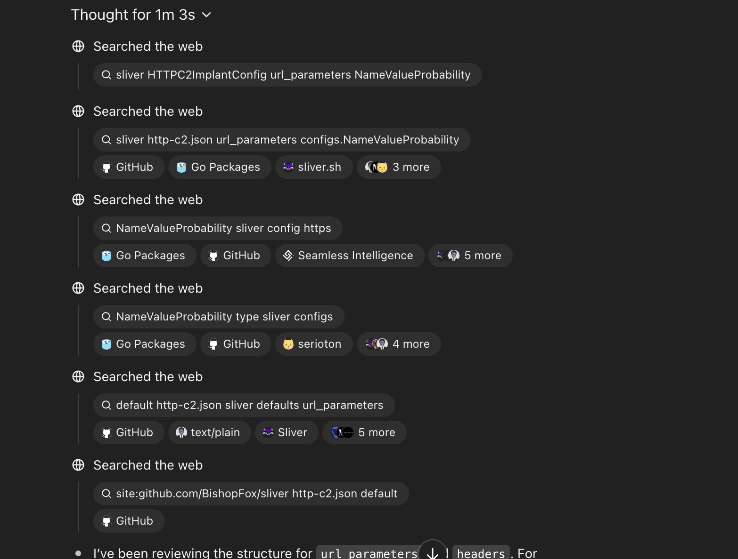
Might not be perfect first attempt, try again :)

Slide 14
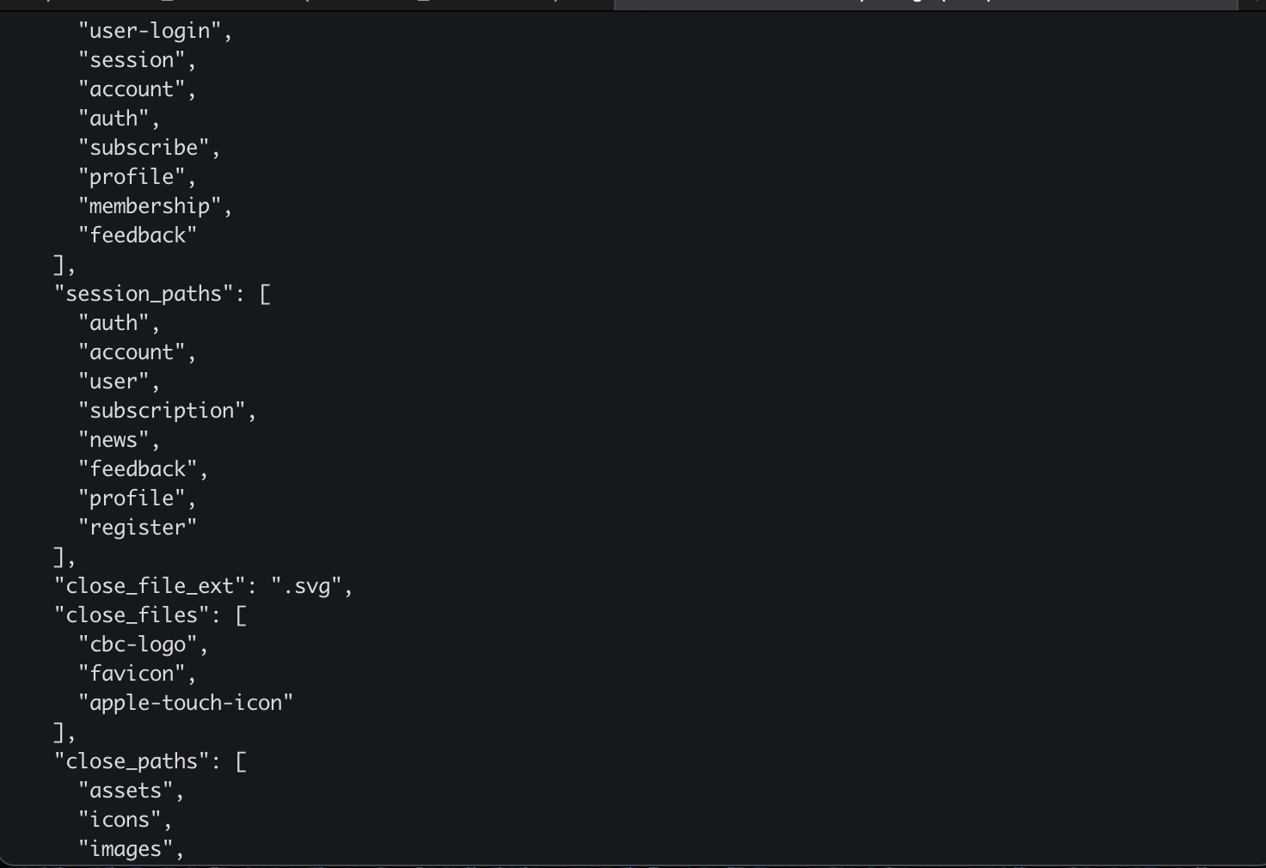
C2 profile result

Slide 15
https://github.com/crpr777/CSW2025-AD-DC604
Make your own!
Download sliver/run sliver
Grab http-json.c2 file
Modify it to your needs and liking with GPT
Generate a python script to do it repeatedly :)
May not work the first time (keep messing with it!)
Version I made is in github repo

Slide 16
LPE + EDR Disabling – Applied Technique 4
Team I was working with identified a simple exploitable LPE (Binary within C:\Temp is run as System whenever SCCM is triggered)
Used GPT to quickly write a C# binary that did the following: When run by SCCM trigger, install provided WDAC policy to a target folder. (Requires Reboot*)
Exploit LPE again and register service binaries

Slide 17
Time Saved
Would have taken 2 hours to manually write the different exploits/binaries on a good day
Developed and deployed dozens of versions within hours using LLM's (WDAC issues led to pain, teams own bad decisions)
Unfortunately cannot share more specifics :P

Slide 18
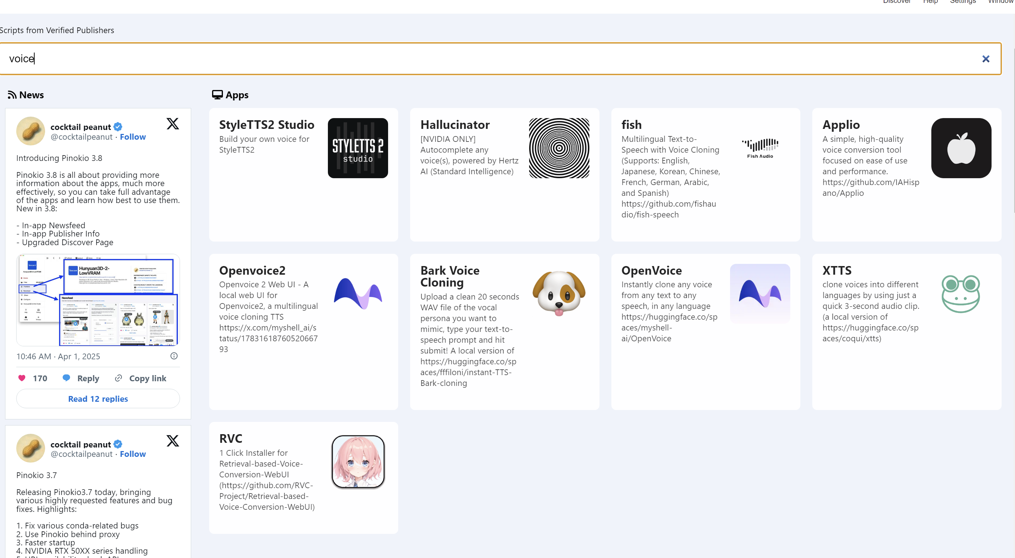

Deepfake creation tools with a single click
Pinokio
https://pinokio.computer/
Pinokio
https://pinokio.computer/

Slide 19
Creating Audio Deepfakes
Install Pinokio
Install Fish TTS and or RVC
Generate text to speech (Fish)
Retrieval Based Voice Conversion (RVC), talk into a microphone -> come out as someone else (voice changer)

Slide 20
Gathering target data
Gather audio from podcast interviews
Chop it up to use with desired tool
Generate speech or train model
Execute attacks with deepfakes (with permission)

Slide 21
Chopping it up
Slice out excerpts of only the target person speaking
Aim for 10-30 seconds for TTS
Aim for 10 minutes for real time deepfake model training

Slide 22
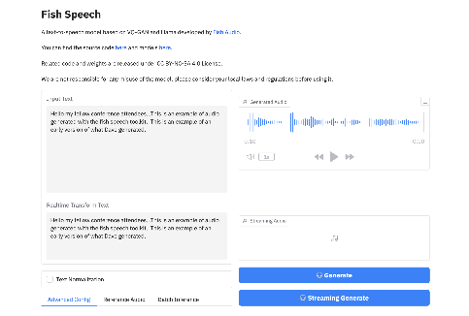


Initial audio Proof of Concepts – Applied technique 5
Text to Audio Tests
Fish Speech
Can clone voices with 10 to 30 seconds of input data
Very quick to generate
Converts text into phonemes (the sounds that make up words)
Uses AI to generate audio that mimics a real voice
Outputs natural-sounding speech from the input text
Not real time (would be hard to use on a phone call, Maybe a Voicemail?)

Slide 23
LLM Task: Help me automate my initial access flow – Creating new tools :)
Help me build automation script to quickly generate initial access implants based on stager templates I have used over the years
Inspired by other initial access kits, and OffensiveNim repo(byt3bl33d3r) Wanted to quickly automate generating nim based implants that worked well for me
SpaceCowboy is born

Slide 24
Tasks sped up
No longer need to open an ide, change fields, compile manually
Just feed SpaceCowboy stager url for shellcode download, template desired and file name.
Generate implant with file hash to add to report
Public release version will not contain [redacted template].
App whitelisting evasion ;)

Slide 25
SpaceCowboy 0.2
Overview
Nim Implant Generation Framework
Staged Shellcode Loaders (Nim)
Basic Sliver shellcode loader, Encrypted Shellcode loader (AES), Fiber based shellcode loader (Can use GPT to make an endless supply of evasive loaders (or your own brain)
Used GPT to customize my templates, and add an automation script which makes compilation with different url endpoints a breeze

Slide 26
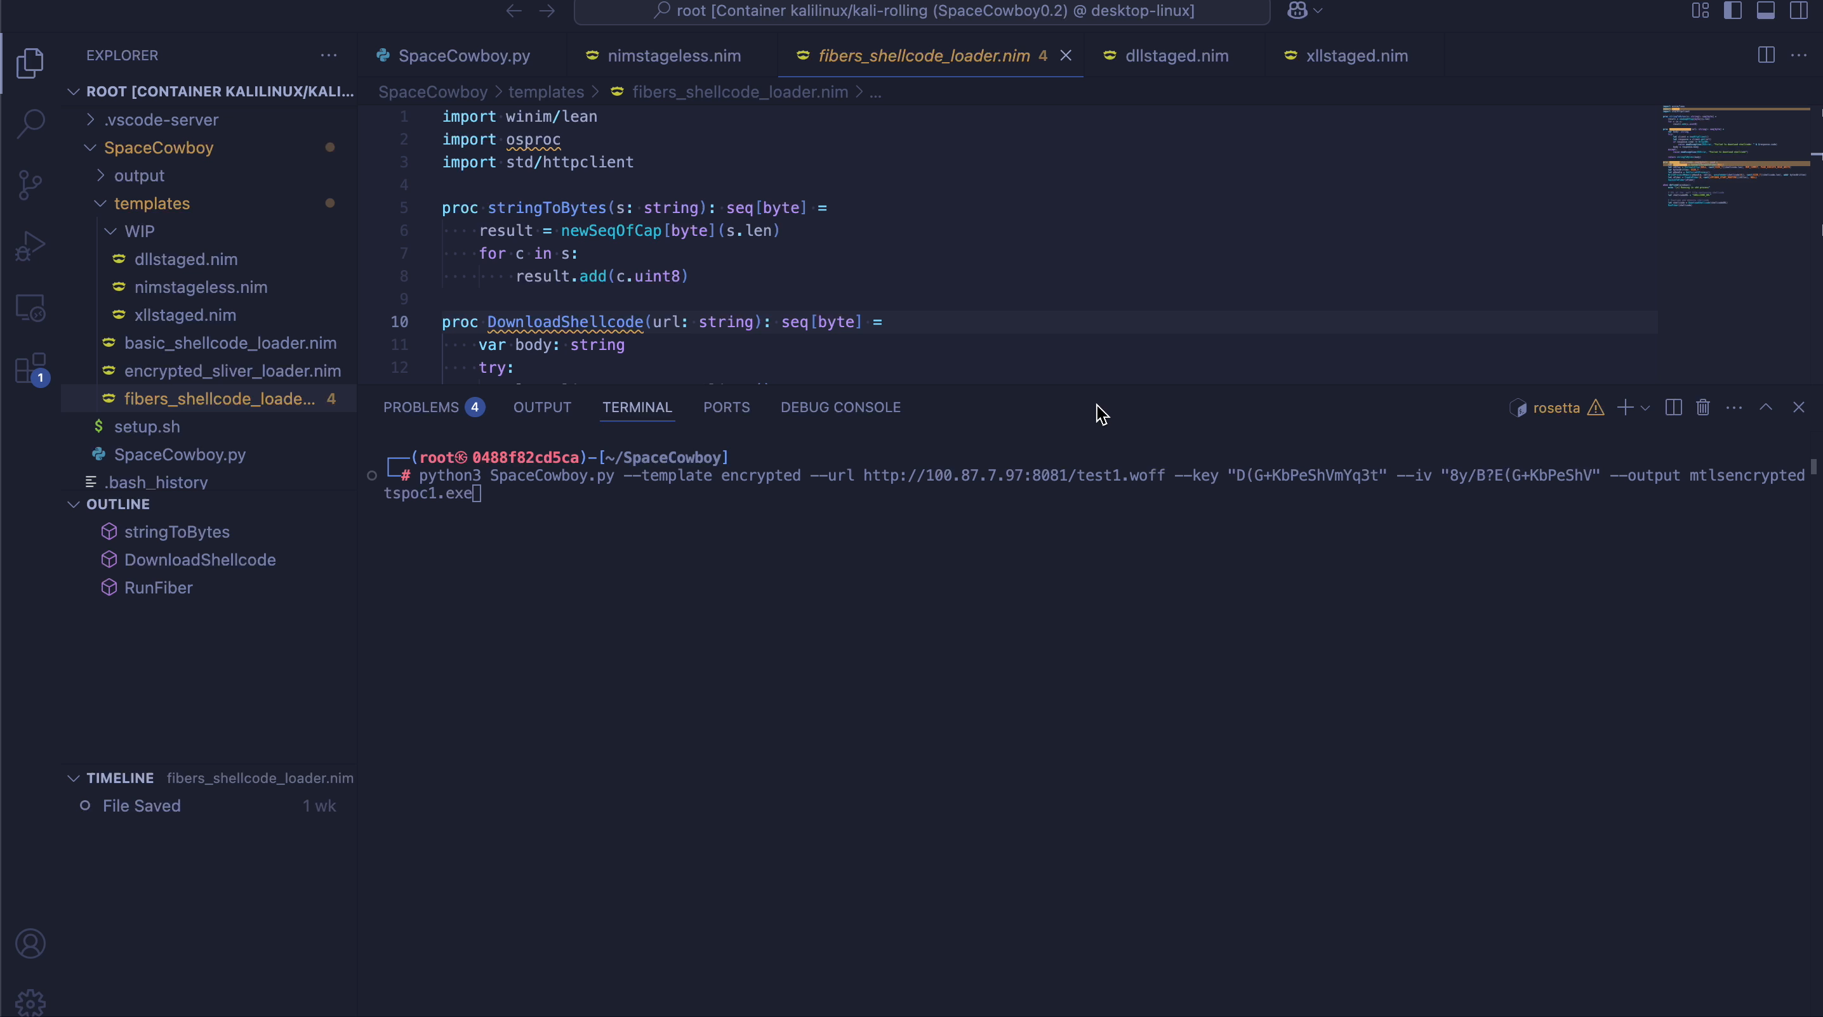
SpaceCowboy Demo

Slide 27
SpaceCowboy Link
https://github.com/crpr777/SpaceCowboy

Slide 28
Laughing Man App
Was playing around with faceswap applications
Wanted to build something with Swift/Xcode
I fucking hate xcode
Used chatGPT to teach me swift, and show me how to use Xcode
Resulted in my own laughing man app in less than an hour

Slide 29

Laughing man Demo

Slide 30
LaughingMan2 Link
https://github.com/crpr777/LaughingMan2

Slide 31
Summary – LLM's/AI has helped us do the following
Generate Dummy code to evade ML Detections
Randomize our https C2 profile with an inspiration website to blend into traffic and evade network detections
Analyze Redirector logs to identify the blue team
Generated exploit code + post exploitation utilities
Create Fake Voices for social engineering campaigns
Automate parts of our own workflow
Create tools in languages we have 0 experience in with IDE's we strongly dislike

Slide 32
Thanks
Thank you DC604!
Thank you everyone who made this research possible :)
Links
https://github.com/crpr777/CSW2025-AD-DC604/blob/main/CanadianBacon.cs
https://github.com/crpr777/CSW2025-AD-DC604/blob/main/http-c2-llmmodified.json
https://github.com/crpr777/SpaceCowboy
https://github.com/crpr777/LaughingMan2
https://pinokio.computer/

